Slide 1

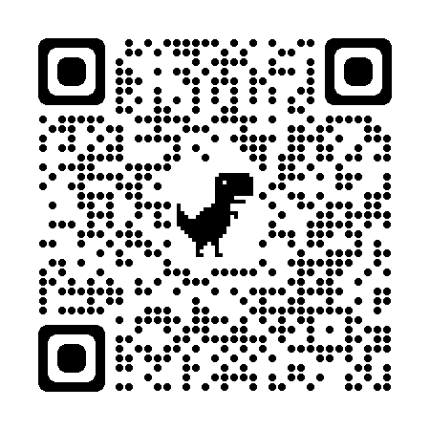

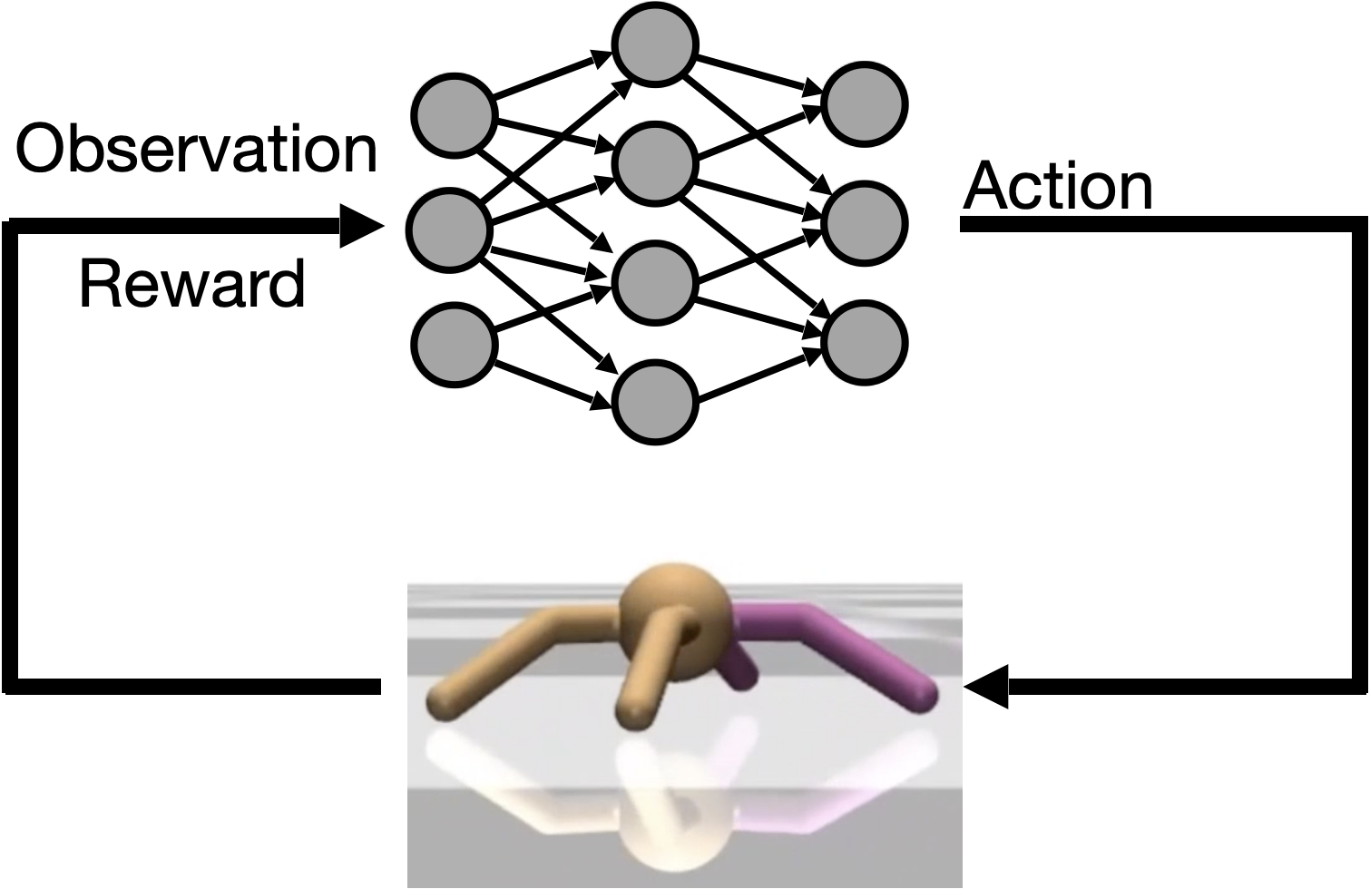
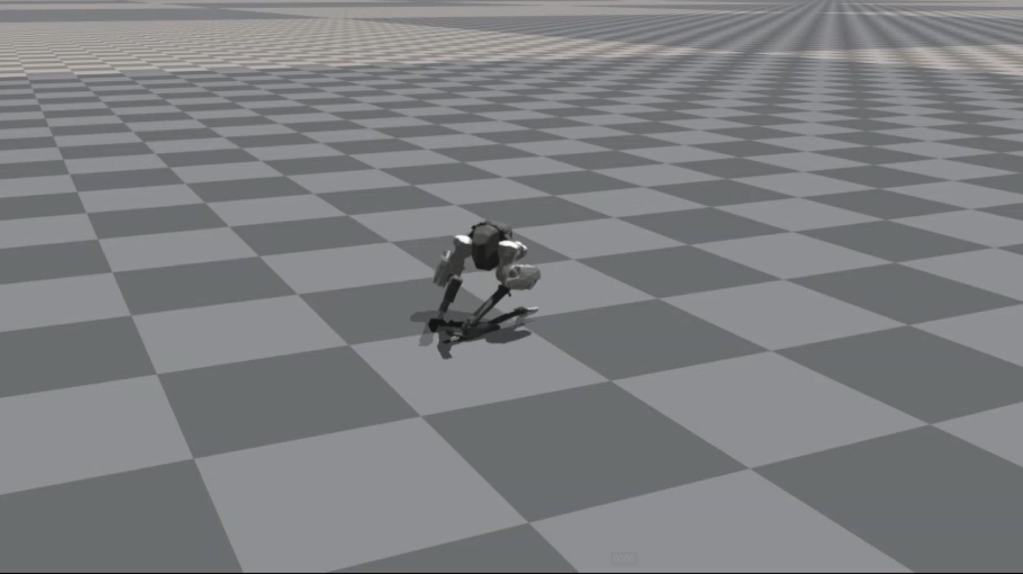
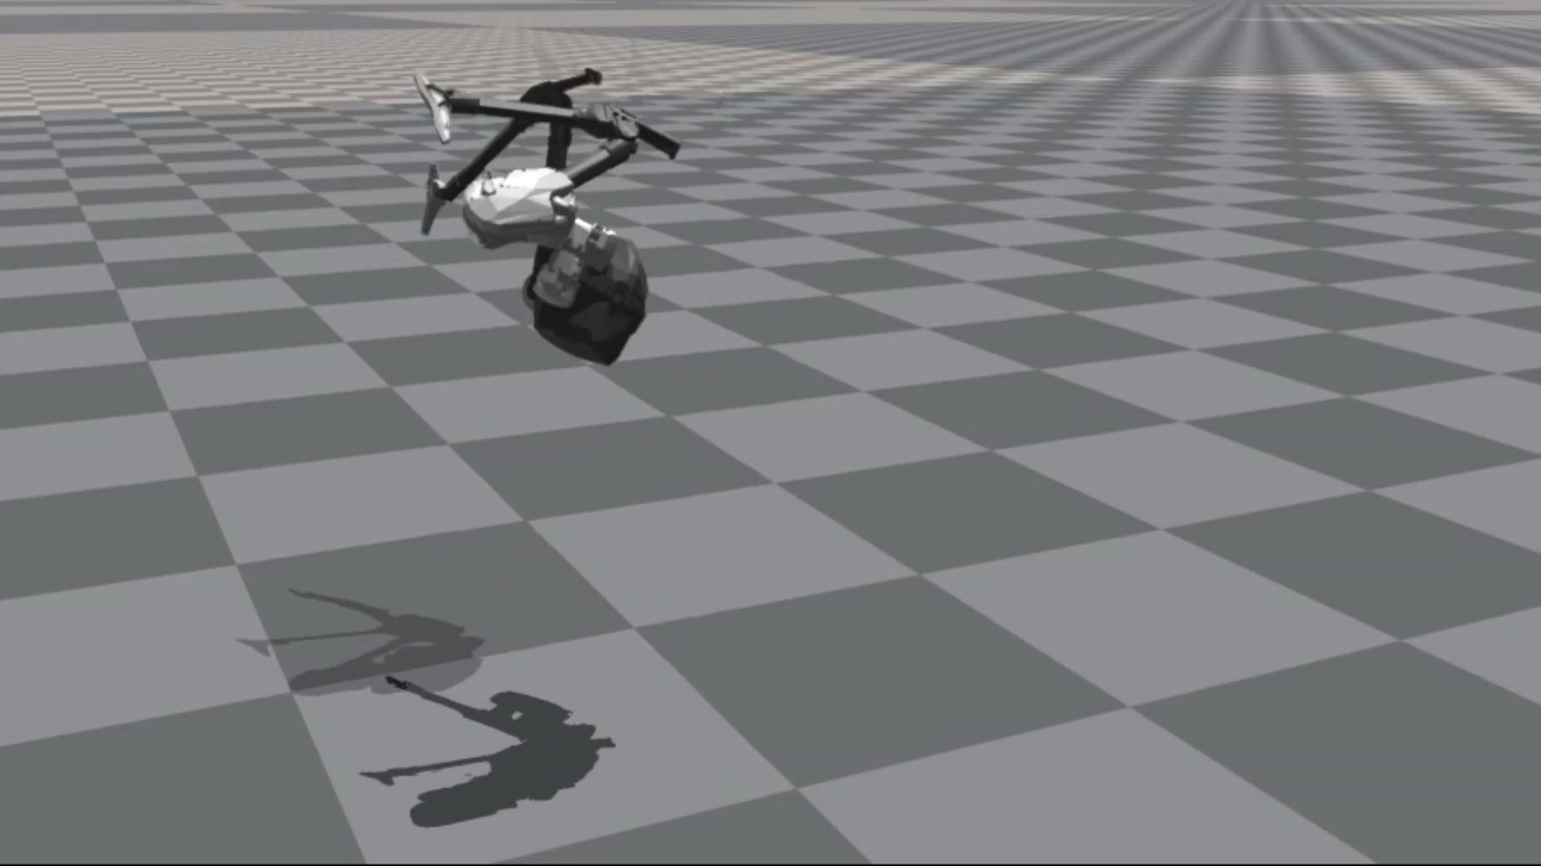
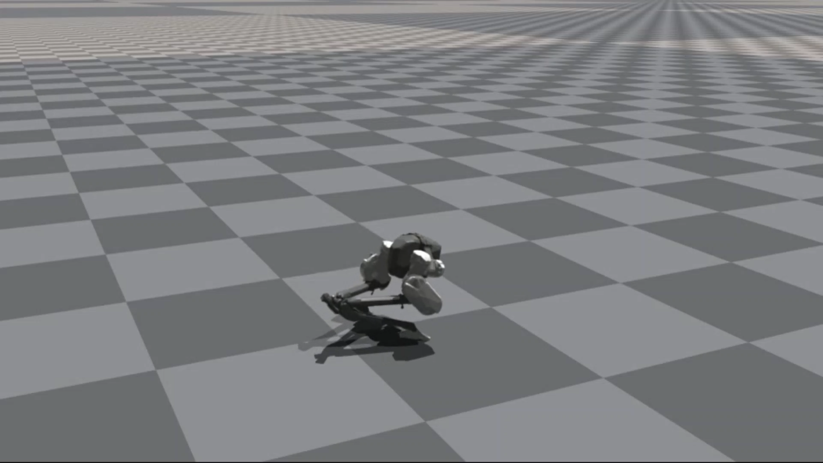
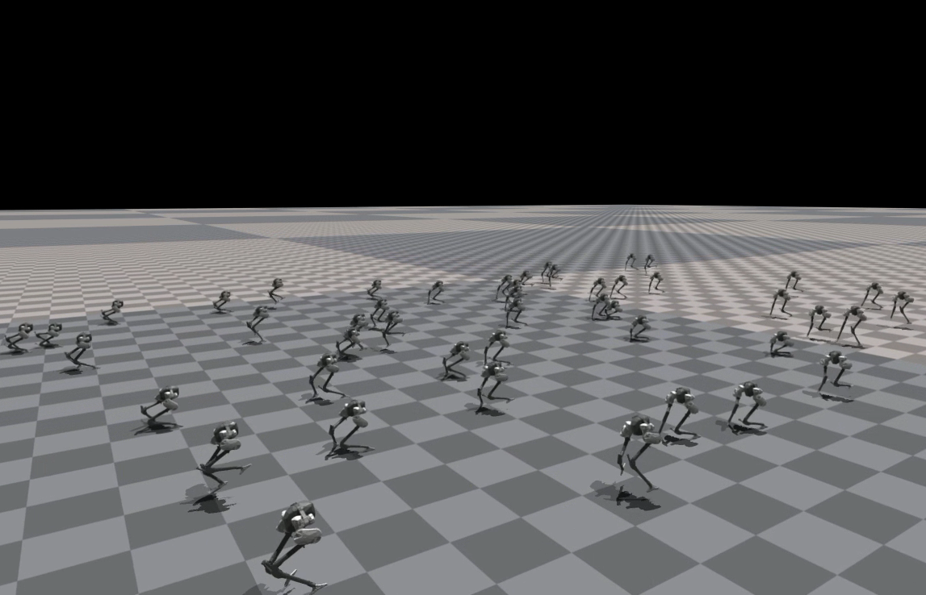
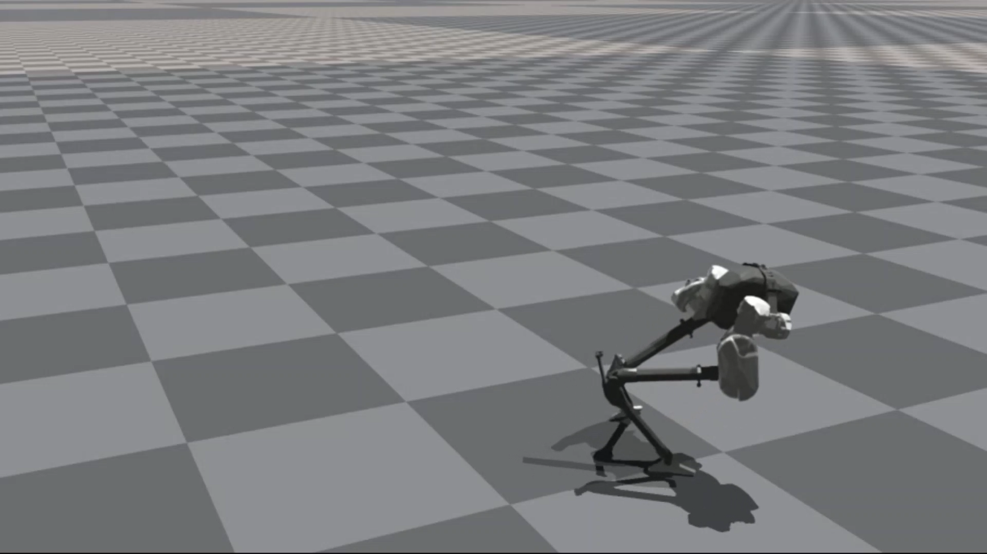
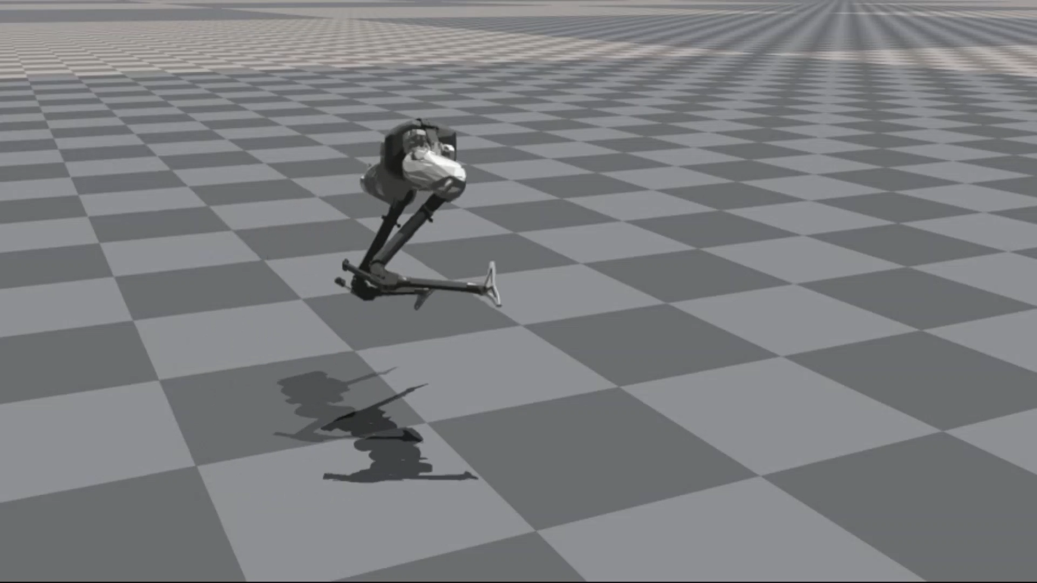
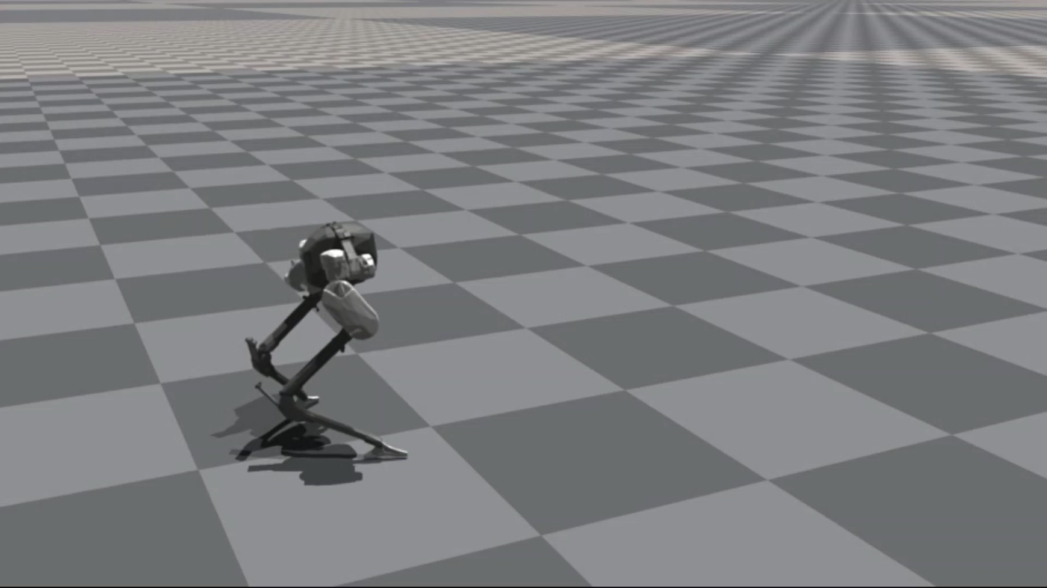
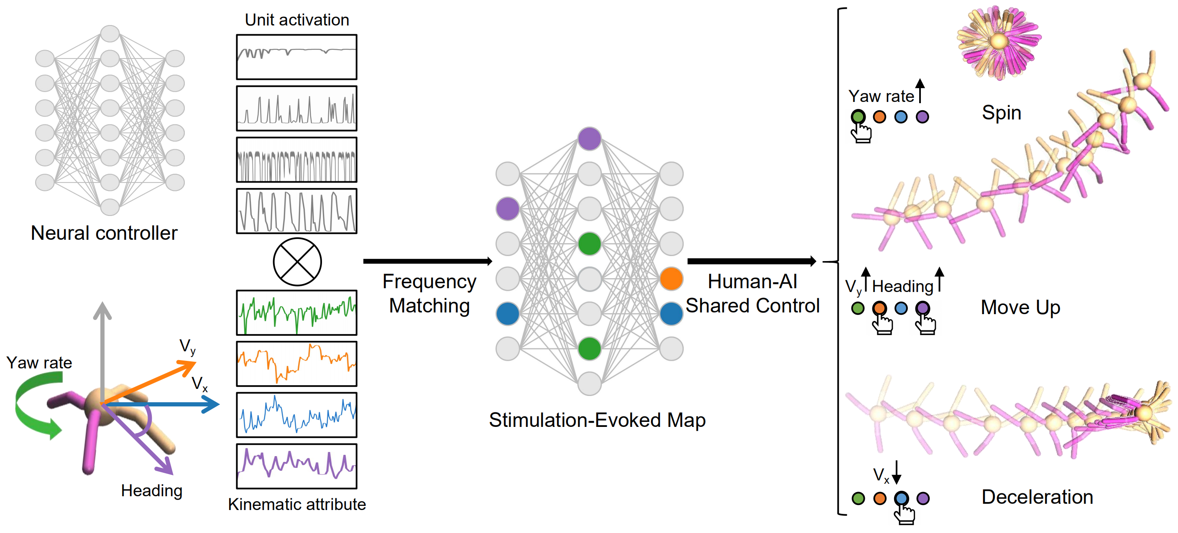
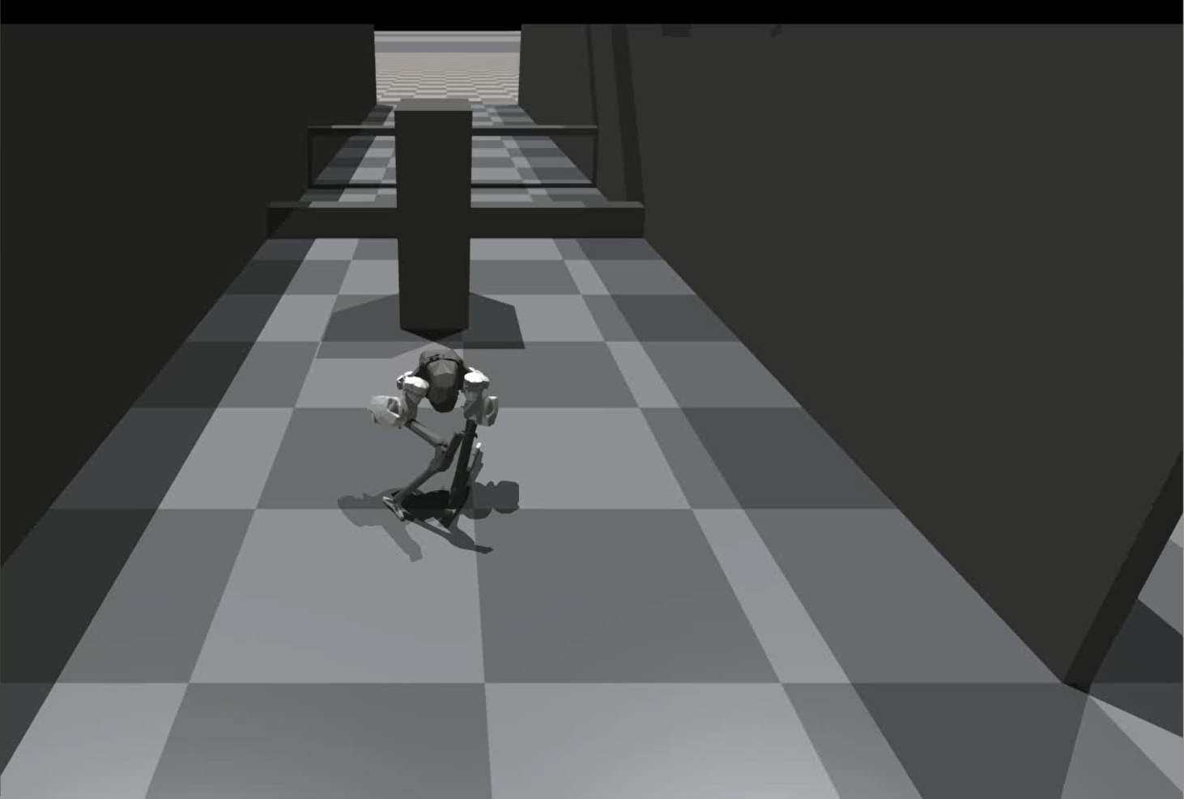
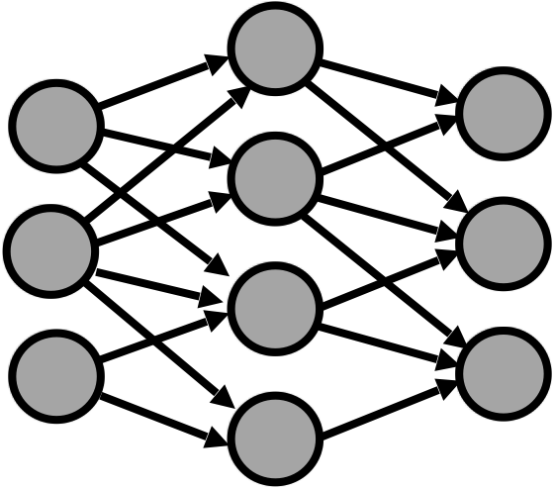
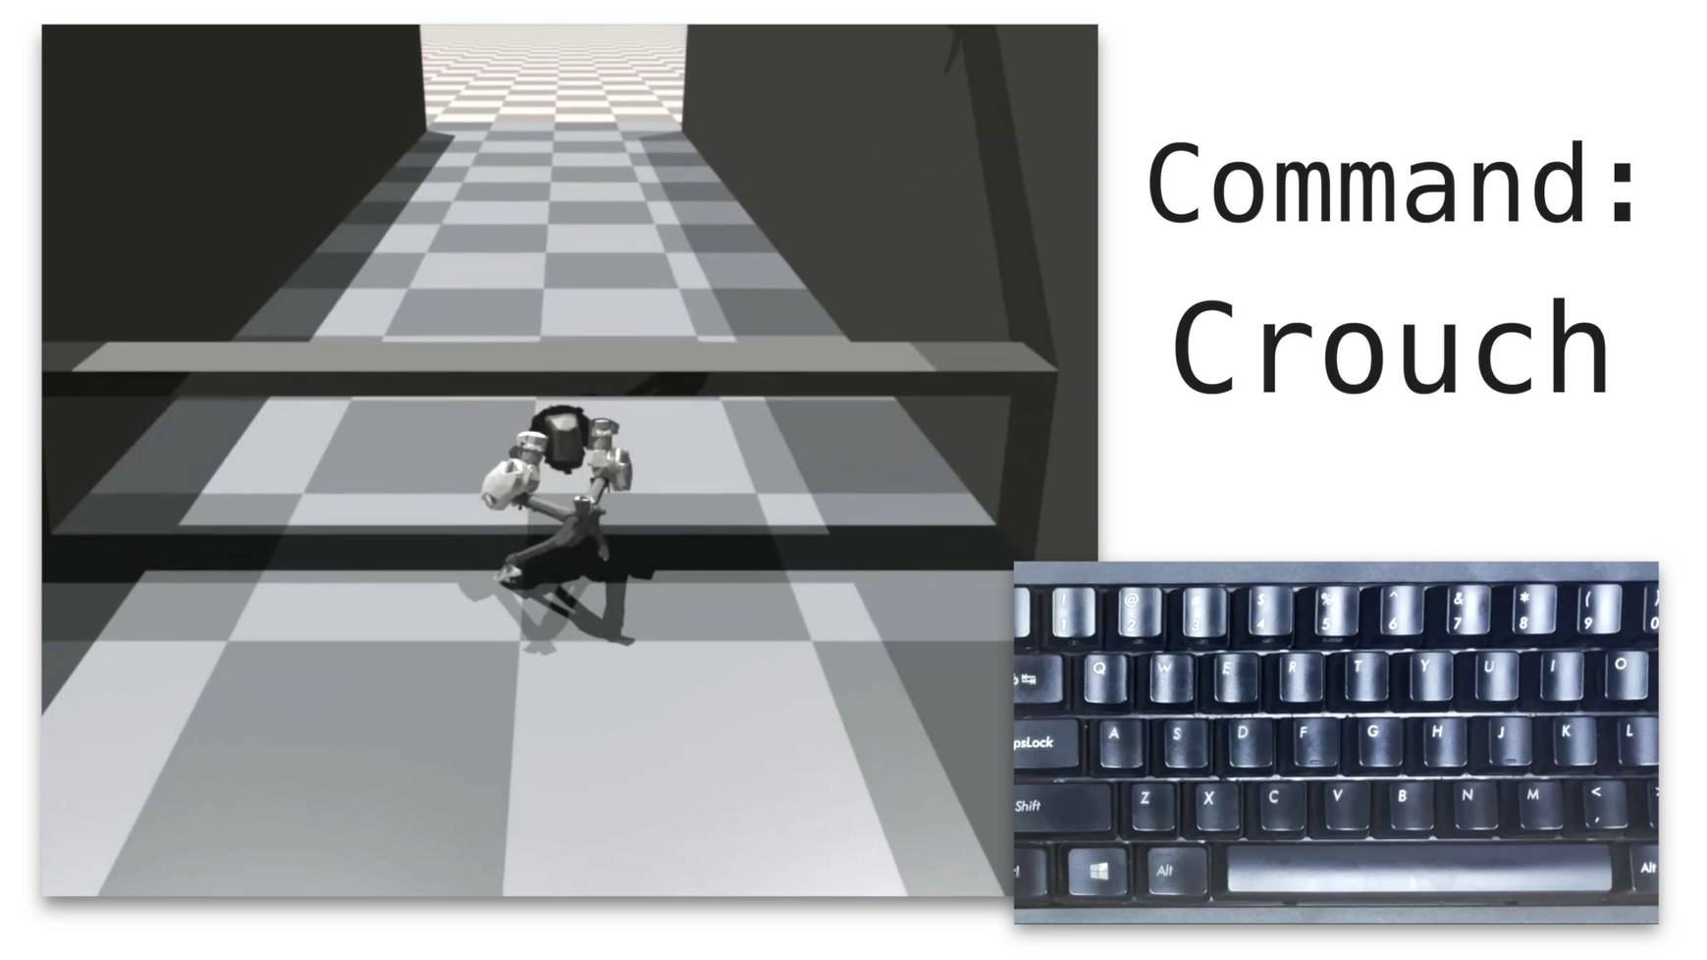
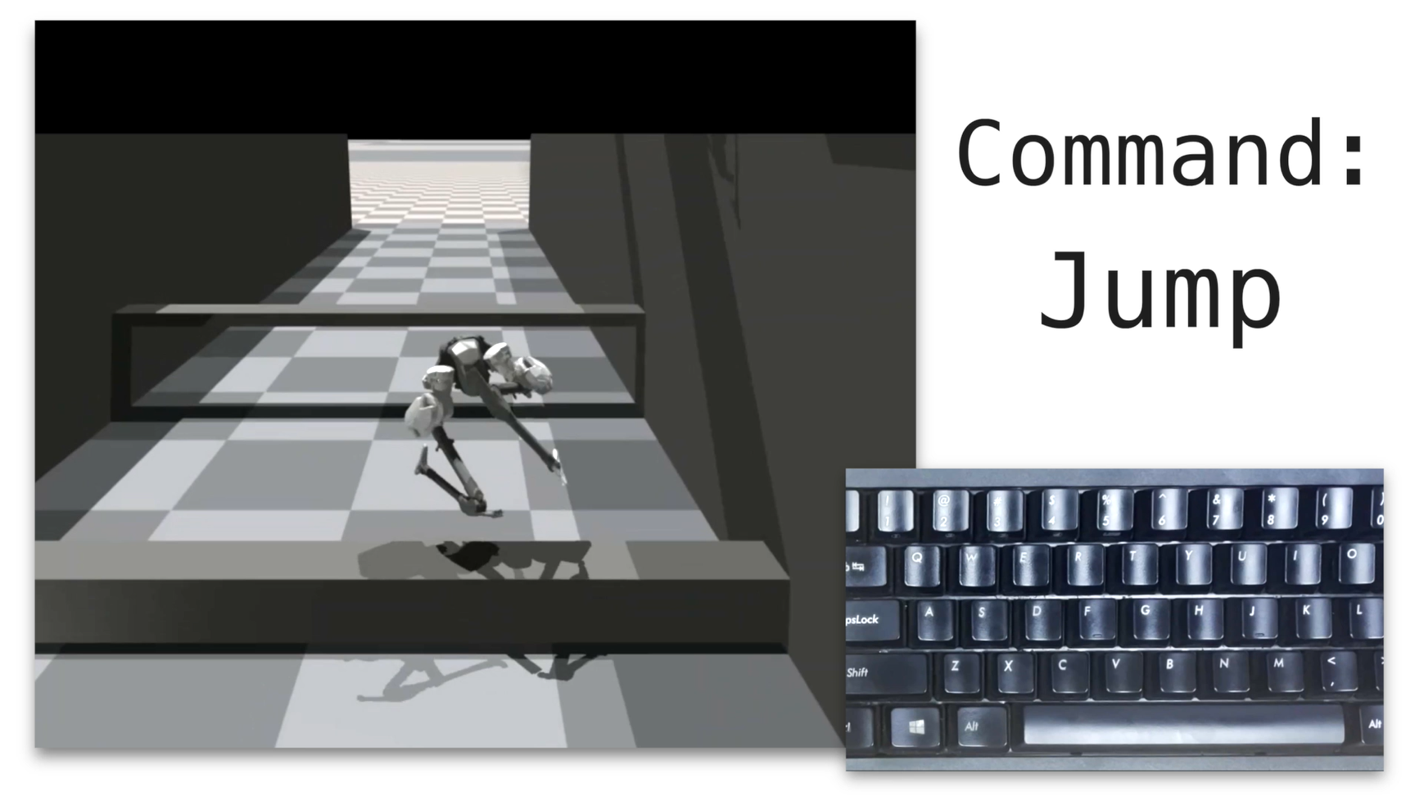
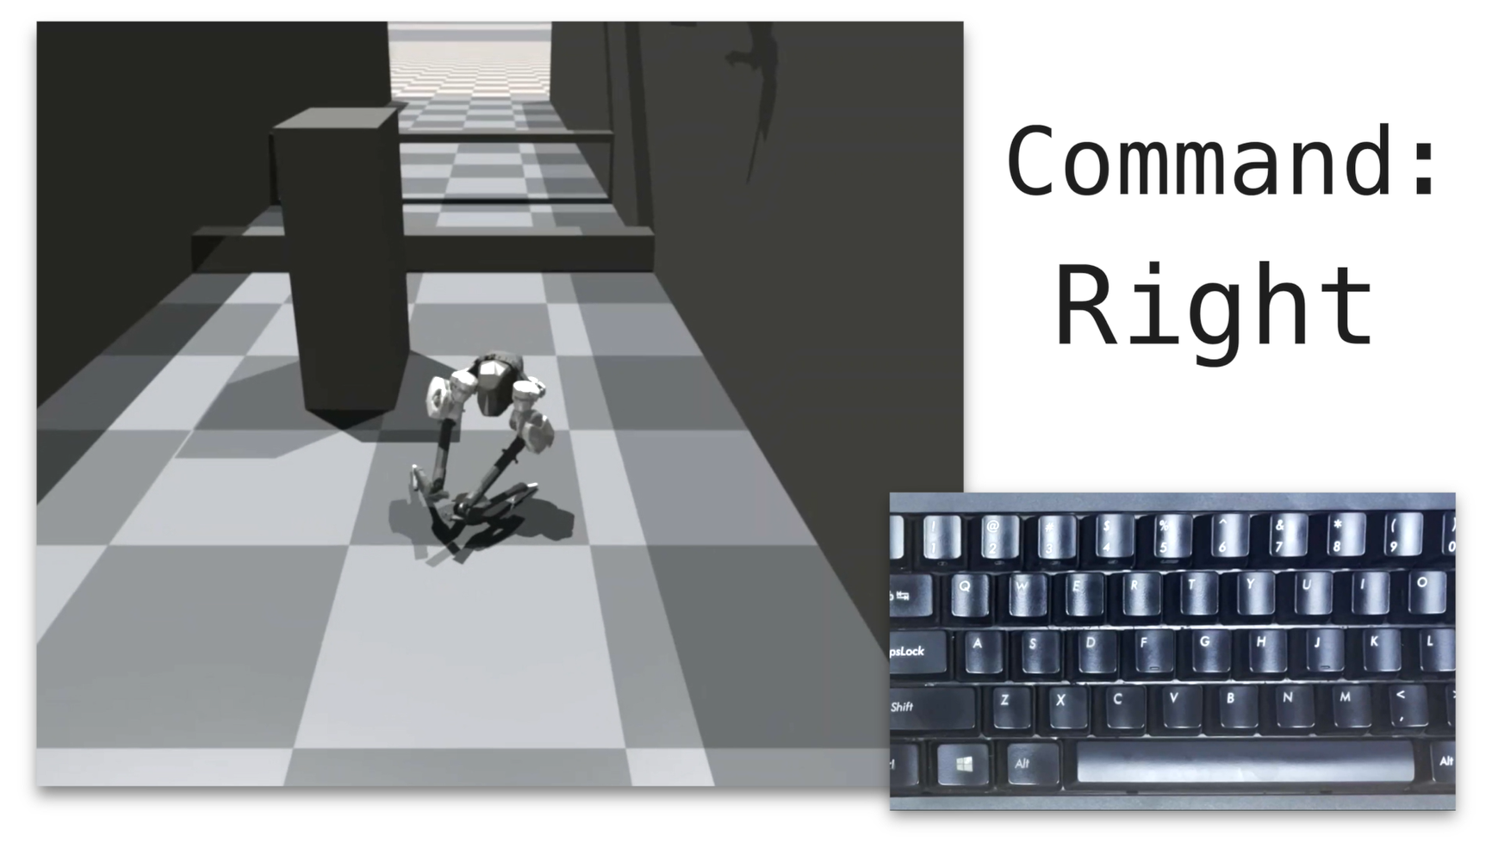
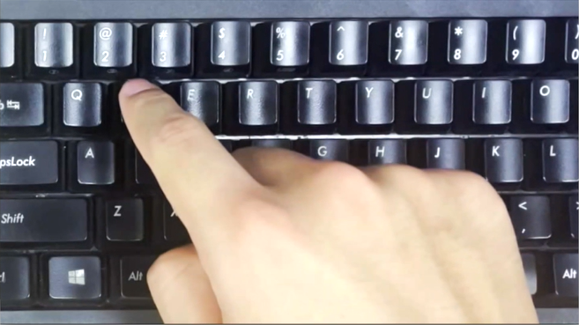
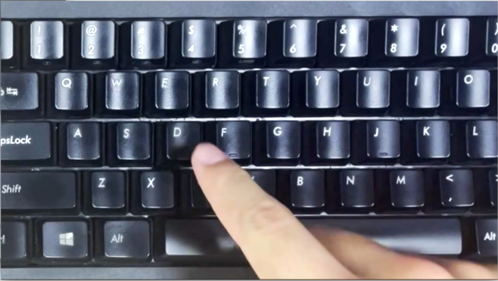
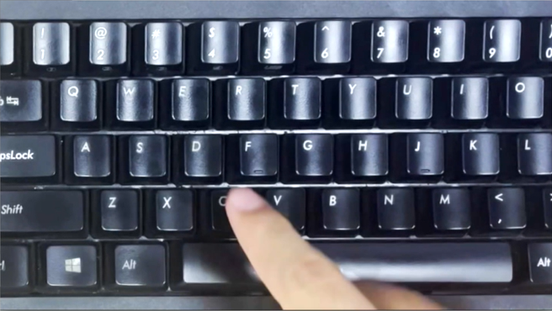
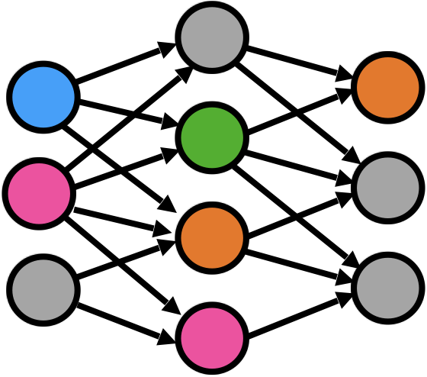
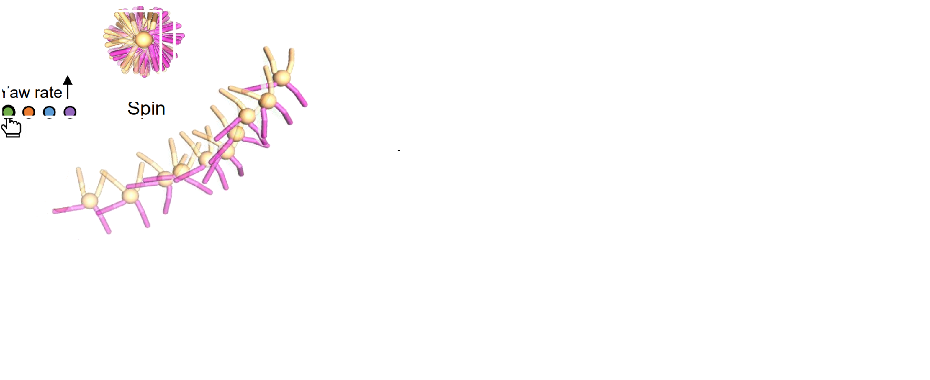
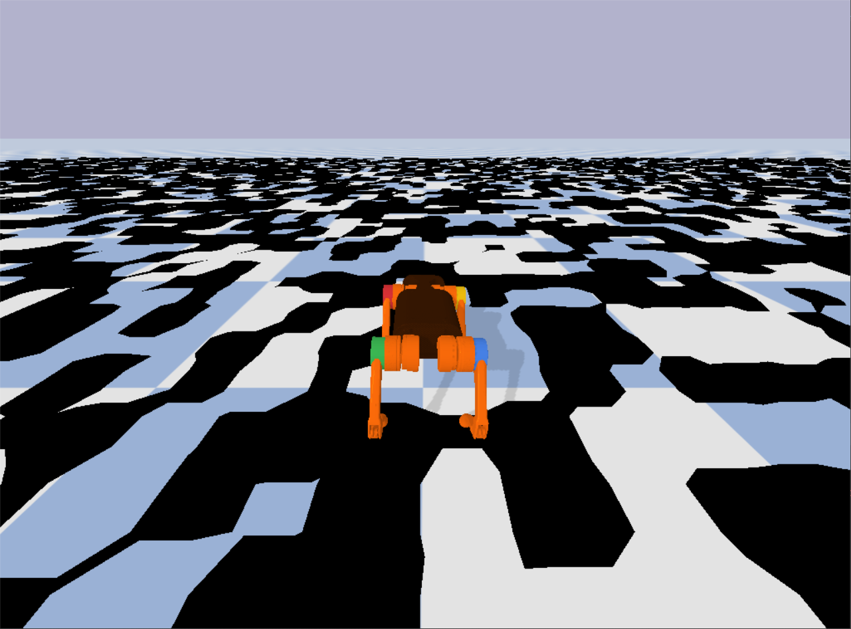
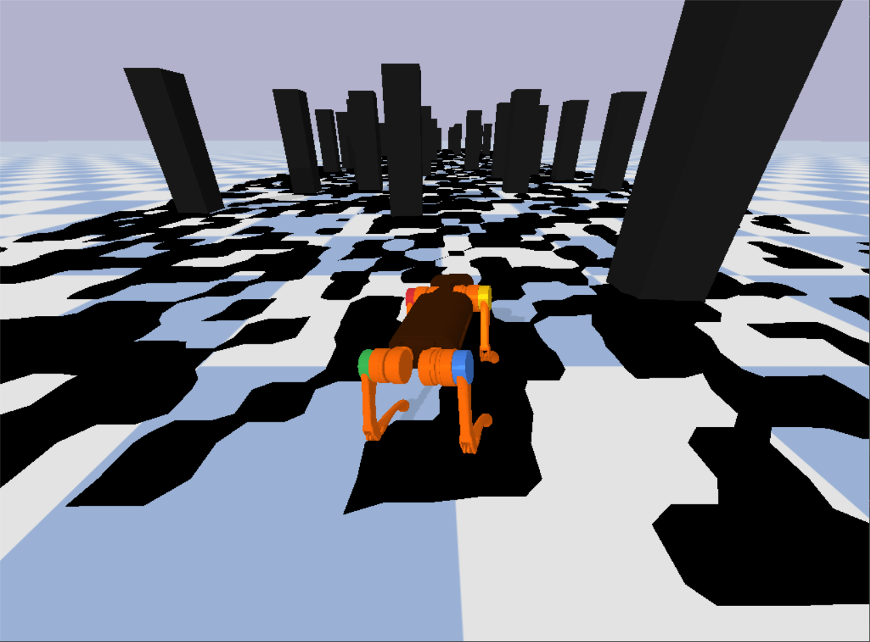
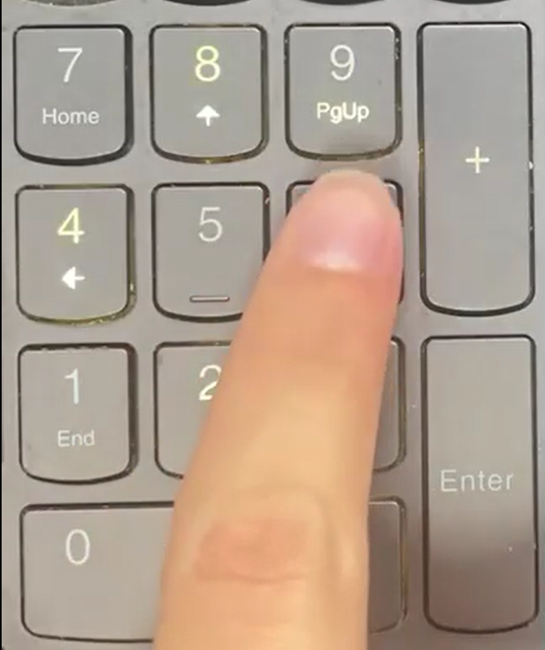
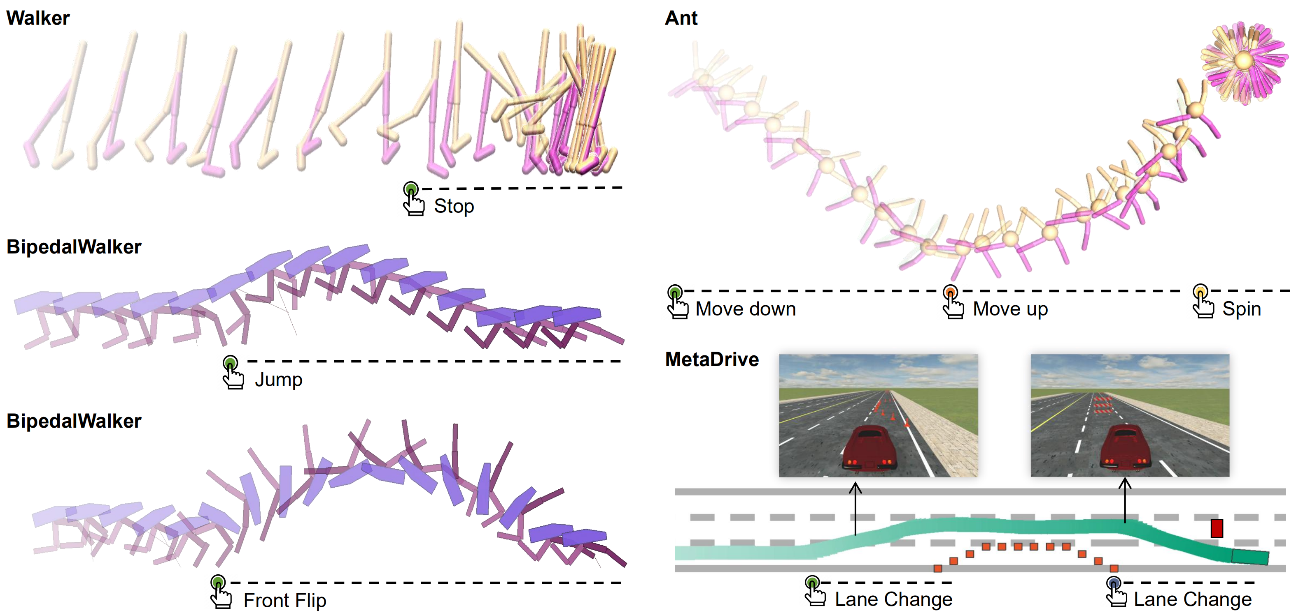
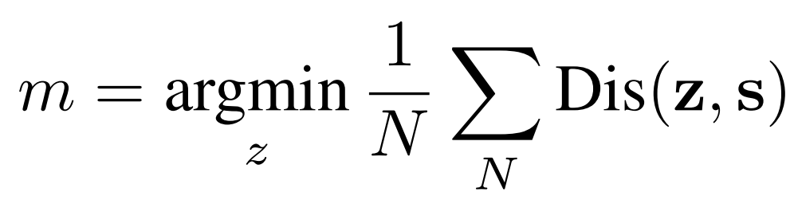
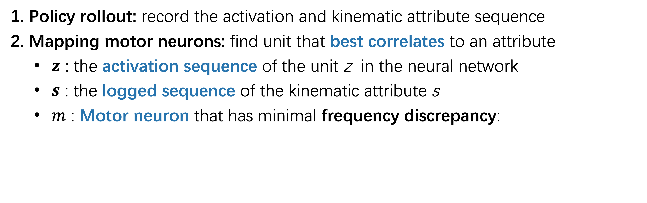
Human-AI Shared Control via Policy Dissection
Quanyi Li^{1,2}, Zhenghao Peng⁴, Haibin Wu², Lan Feng³, Bolei Zhou⁴
¹University of Edinburgh, ²Centre for Perceptual and Interactive Intelligence, ³ETH Zurich, ⁴University of California, Los Angeles
Experiments
Bipedal Cassie Robot
Code is available
Motivation
Agent trained from RL
Discovered Skills
Interpretability: What has been learned in the internal of the agent?
Controllability: How to control the agent?
Application for Human-AI collaboration
Policy
Dissection
Turn Left
Back Flip
Crouch
Training Task: Move Forward
Probing the Representation of the Agent
Turn Right
Jump
Tip-toe
Neural Activation
Human-AI Shared Control
Policy Dissection
Test environment
Time-series
frequency matching
Mapping
Evoking
Human-AI Shared Control for Task Generalization
Setting | Reward
Agent in Training Env | 448.32
Agent in Test Env | 18.23
Agent+Human in Test Env | 413.93
Agent Trained in Test Env | 445.47
Kinematic Attributes
1. Policy rollout: record the activation and kinematic attribute sequence
2. Mapping motor neurons: find unit that best correlates to an attribute
$z$ : the activation sequence of the unit z in the neural network
$s$ : the logged sequence of the kinematic attribute s
$m$ : Motor neuron that has minimal frequency discrepancy:
Training Environment
Test Environment
Results on More Environments
(Side View)
MetaDrive
3. Evoking certain behavior: manually activate a group of motor neurons associated with certain kinematics
(Side View)

